Slide 1

Construction of semiconductor device
Diodes are constructed as a single piece of semiconductor material with one side doped with p-type material and the other side with n-type material
HOME ASGNMT-1:- Process of Construction

Slide 2
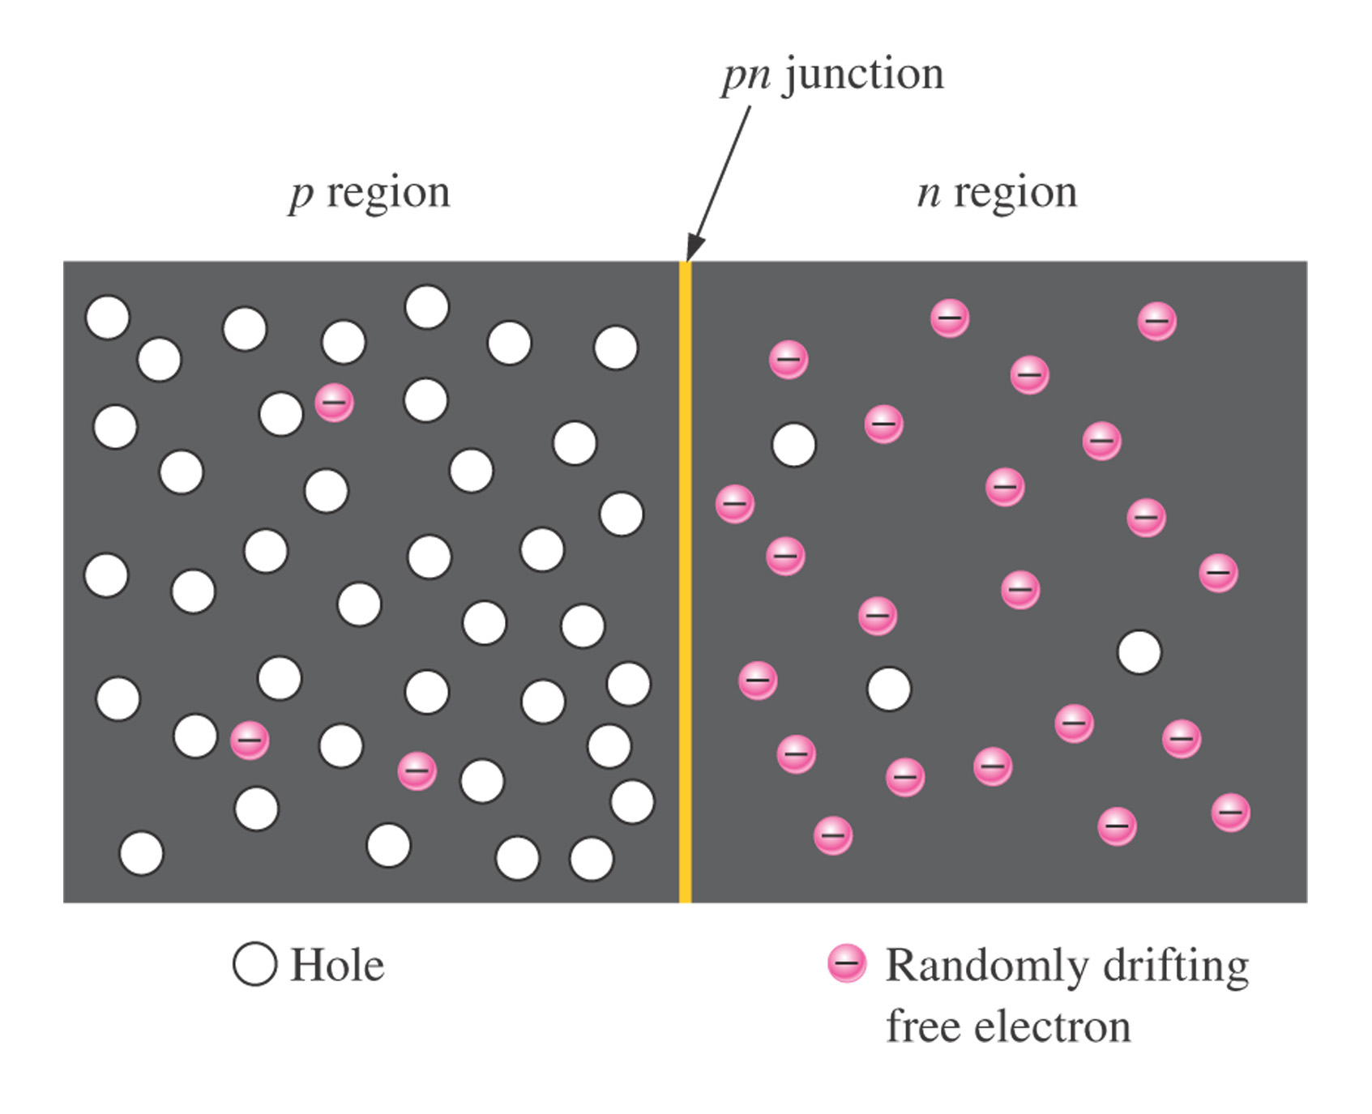
Figure -1 The basic diode structure at the instant of junction formation showing only the majority and minority carriers.
Thomas L. Floyd
Electronic Devices, Electron Flow Version, 5e
Copyright ©2005 by Pearson Education, Inc.
Upper Saddle River, New Jersey 07458
All rights reserved.

Slide 3
PN Junction
After the initial surge of charge across the junction, the depletion region acts as a barrier to the further movement of electrons across the junction.

Slide 4
The PN Junction
Steady State
Metallurgical Junction
Na
Nd
When no external source is connected to the pn junction, diffusion and drift balance each other out for both the holes and electrons
- - - - -
- - - - -
- - - - -
- - - - -
+ + + + +
+ + + + +
+ + + + +
+ + + + +
P
n
ionized acceptors
Space Charge Region
ionized donors
E-Field
+
+
_
_
=
=
=
h+ drift
=
h+ diffusion
e- diffusion
e- drift
Space Charge Region: Also called the depletion region. This region includes the net positively and negatively charged regions. The space charge region does not have any free carriers.
Metallurgical Junction: The interface where the p- and n-type materials meet.
Na & Nd: Represent the amount of negative and positive doping in number of carriers per centimeter cubed. Usually in the range of 10¹⁵ to 10²⁰.

Slide 5
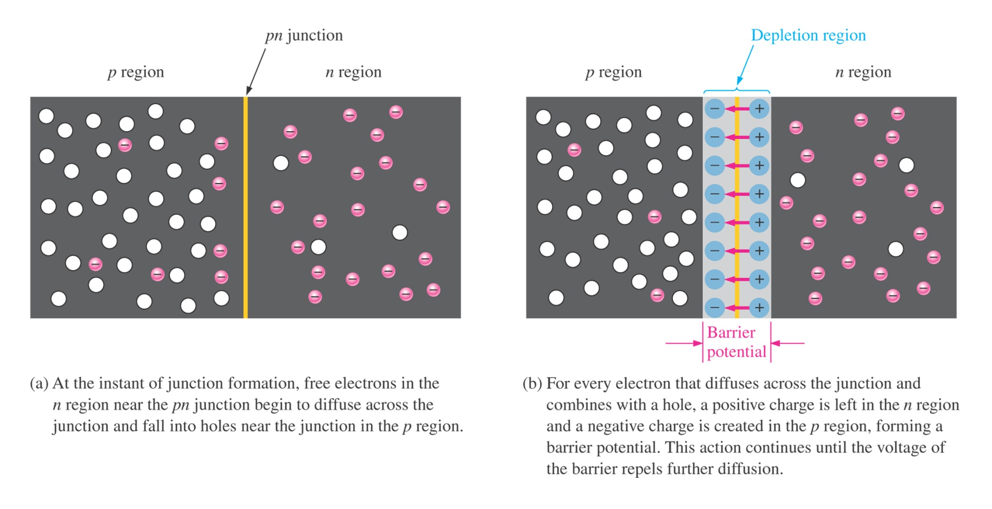
Figure - Formation of the depletion region. The width of the depletion region is exaggerated for illustration purposes.

Slide 6
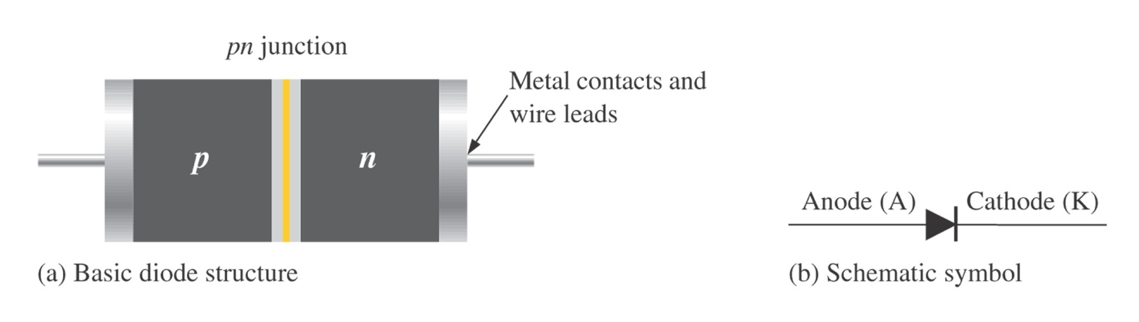
Figure 1–31 Diode structure and schematic symbol.

Slide 7
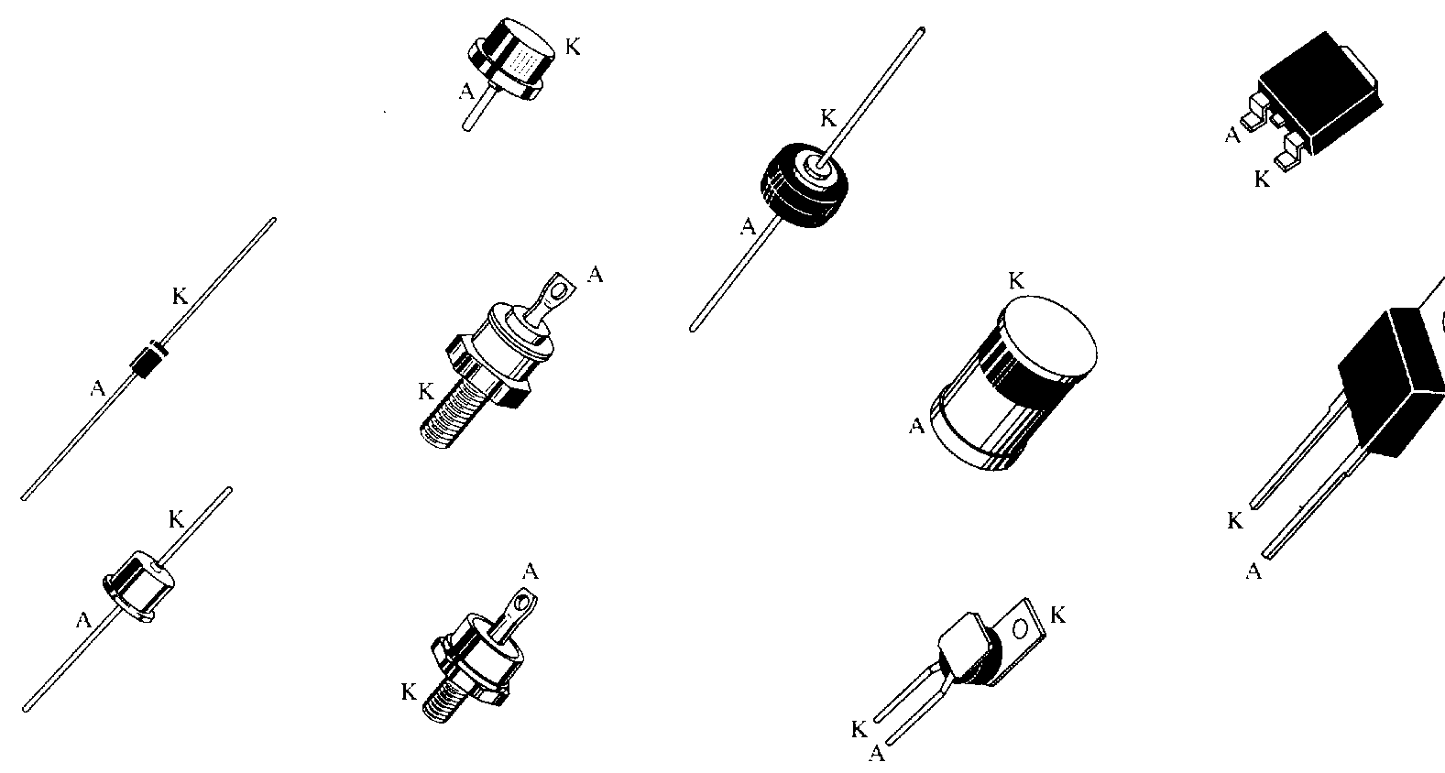
Types of Diodes

Slide 8
BIAS
The use of a dc voltage to establish certain operating conditions for an electronic device

Slide 9
FORWARD BIAS

Slide 10
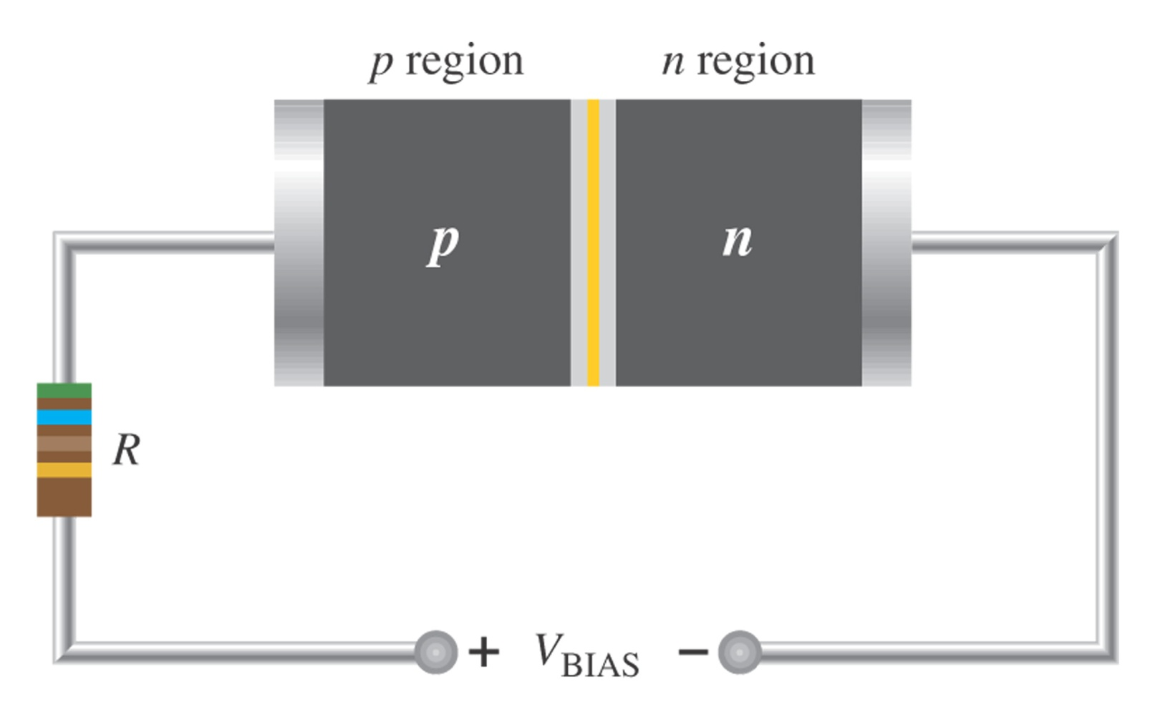
Figure 1–20 A diode connected for forward bias.

Slide 11
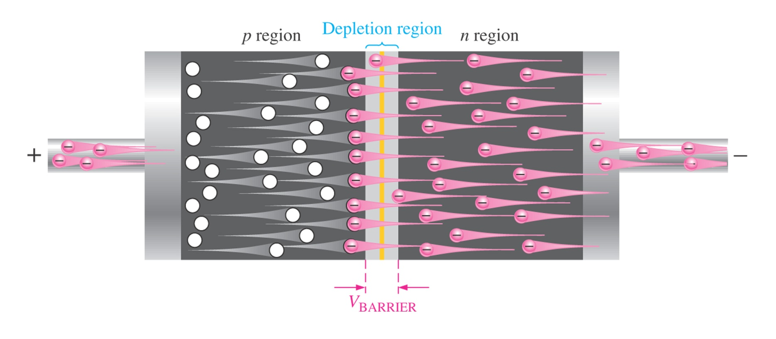
Figure 1–21 A forward-biased diode showing the flow of majority carriers and the voltage due to the barrier potential across the depletion region.

Slide 12
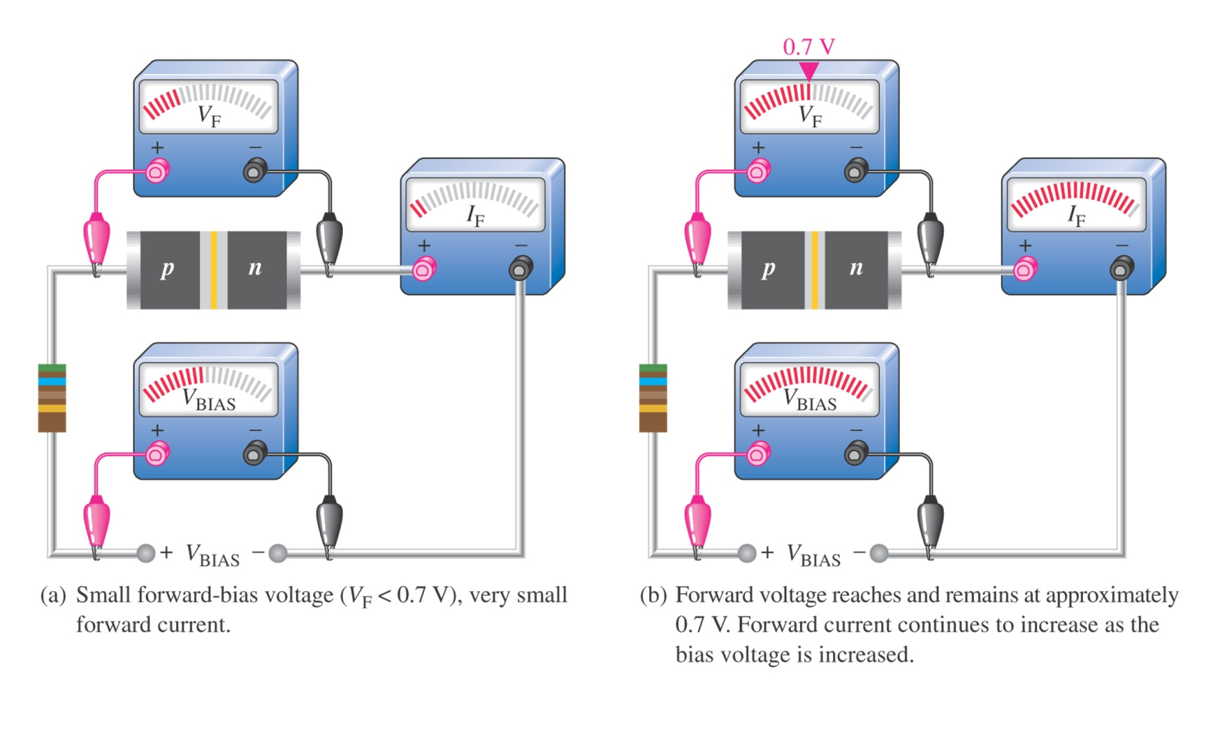
Figure 1–26 Forward-bias measurements show general changes in V_{F} and I_{F} as V_{BIAS} is increased.

Slide 13
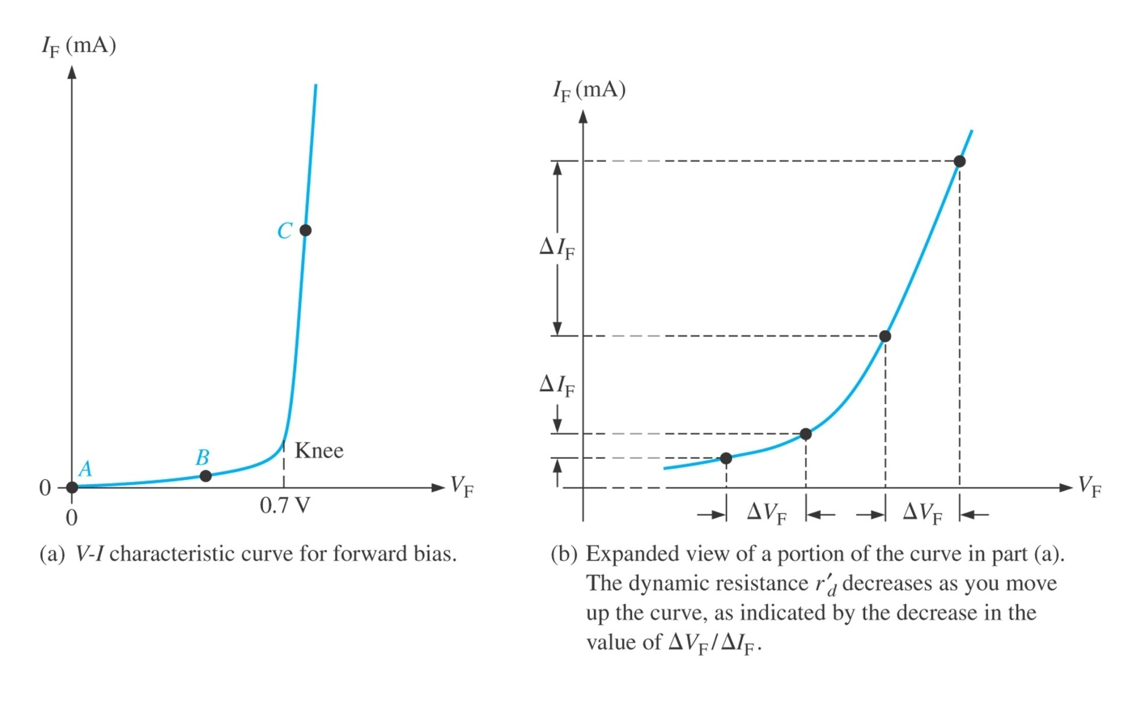
Figure 1–27 Relationship of voltage and current in a forward-biased diode.

Slide 14
The Biased PN Junction
Forward Bias:
In forward bias the depletion region shrinks slightly in width. With this shrinking the energy required for charge carriers to cross the depletion region decreases exponentially. Therefore, as the applied voltage increases, current starts to flow across the junction. The barrier potential of the diode is the voltage at which appreciable current starts to flow through the diode. The barrier potential varies for different materials.
V_{applied} > 0
Reverse Bias:
Under reverse bias the depletion region widens. This causes the electric field produced by the ions to cancel out the applied reverse bias voltage. A small leakage current, Is (saturation current) flows under reverse bias conditions. This saturation current is made up of electron-hole pairs being produced in the depletion region. Saturation current is sometimes referred to as scale current because of it’s relationship to junction temperature.
V_{applied} < 0

Slide 15
Reverse Bias

Slide 16
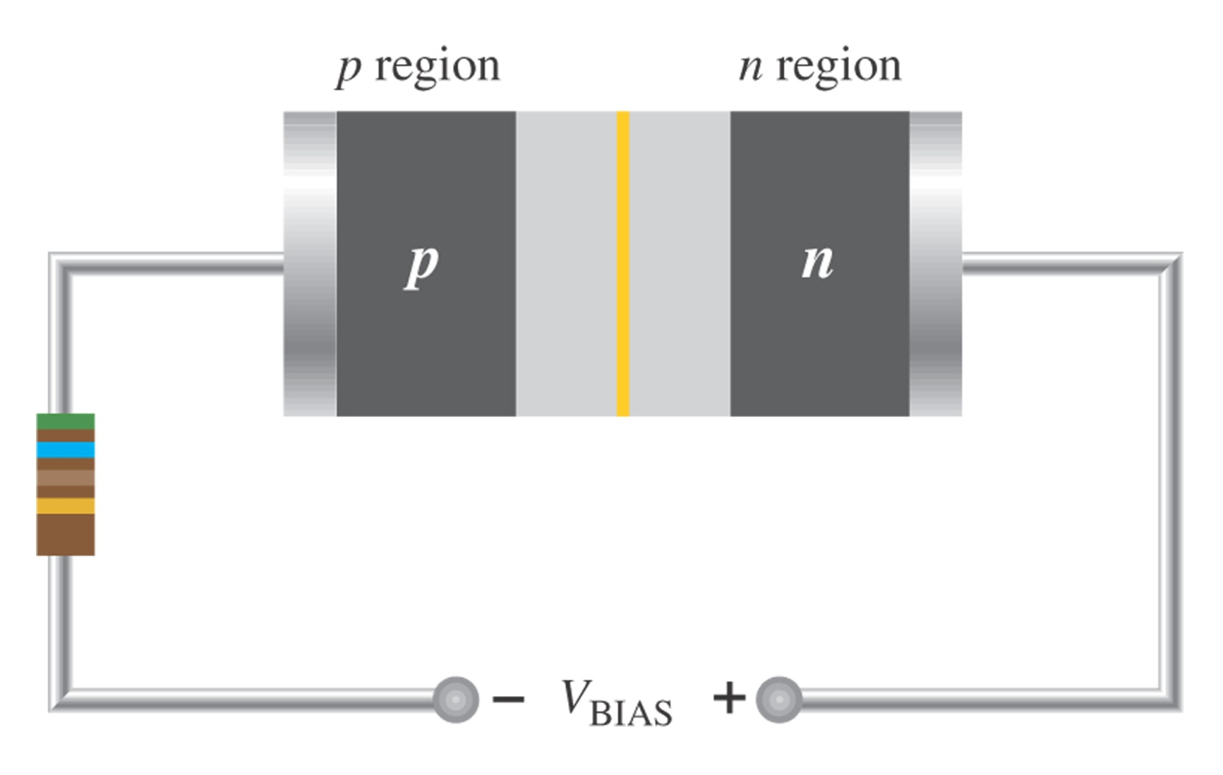
Figure 1–23 A diode connected for reverse bias. A limiting resistor is shown although it is not important in reverse bias because there is essentially no current.

Slide 17
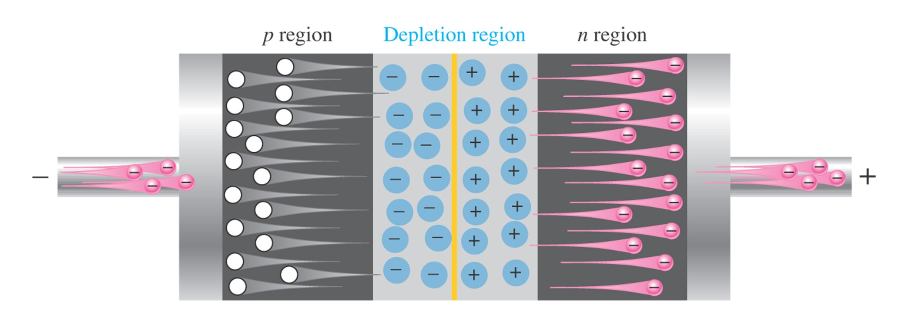
Figure 1–24 The diode during the short transition time immediately after reverse-bias voltage is applied.

Slide 18
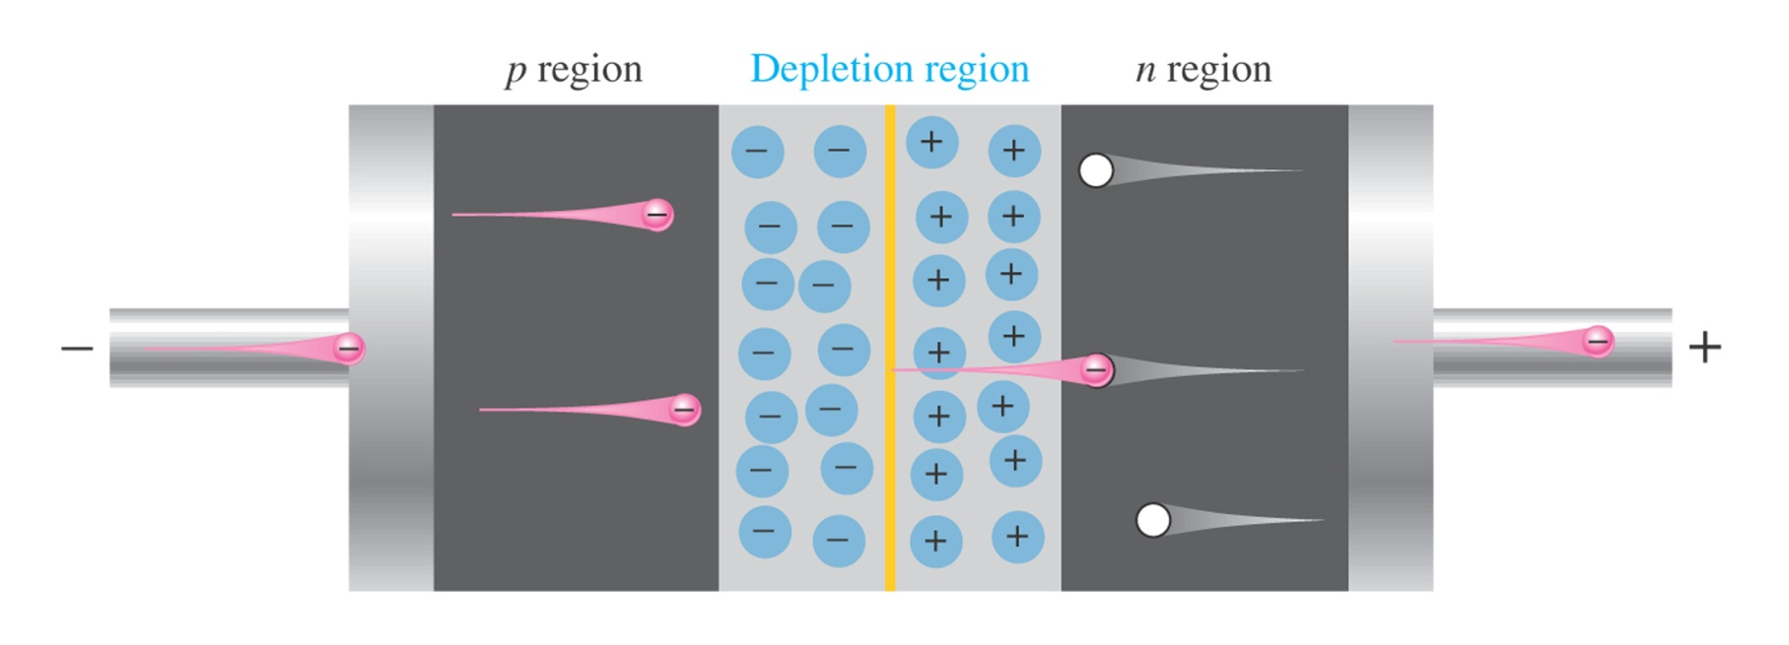
Figure 1–25 The extremely small reverse current in a reverse-biased diode is due to the minority carriers from thermally generated electron-hole pairs.

Slide 19
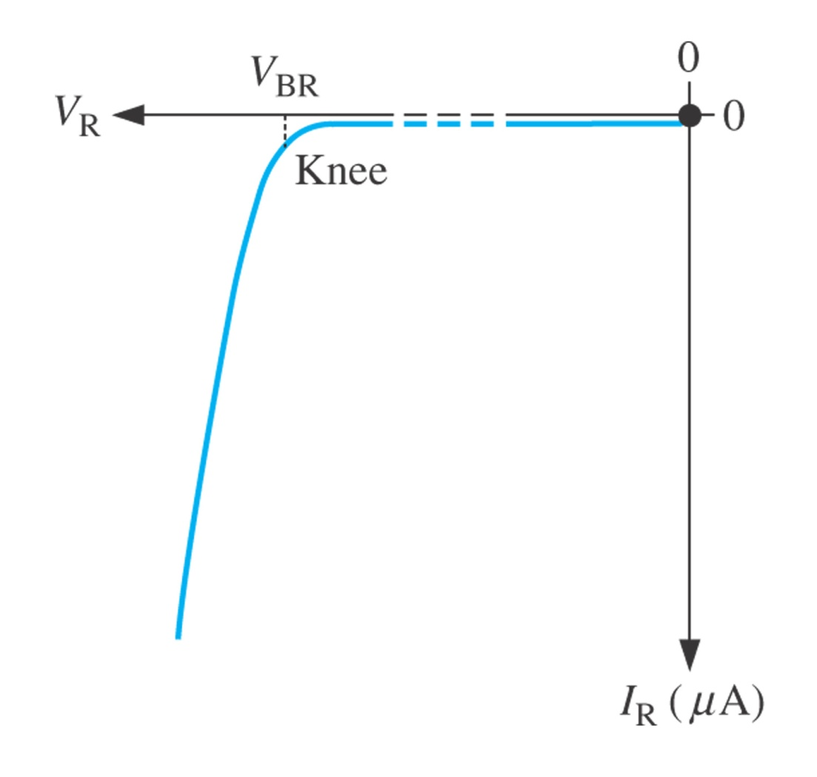
Figure 1–28 V-I characteristic curve for a reverse-biased diode.

Slide 20
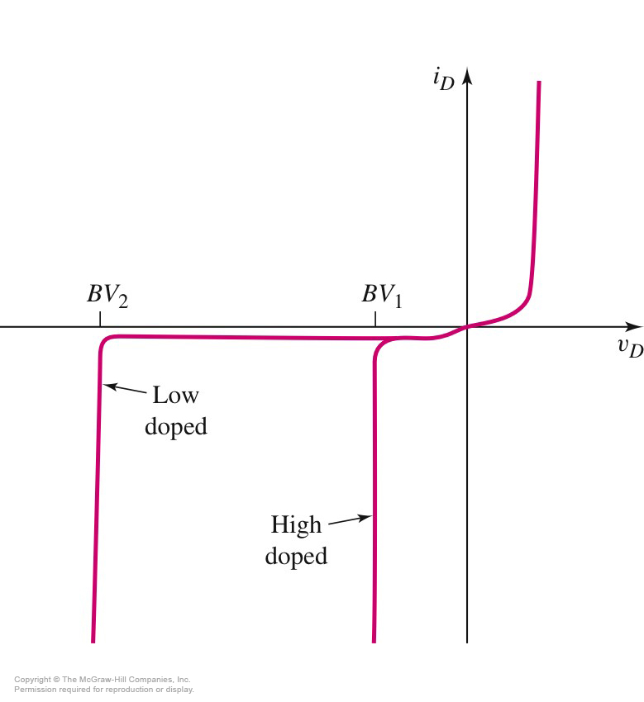
Breakdown Voltage
The magnitude of the breakdown voltage (BV) is smaller for heavily doped diodes as compared to more lightly doped diodes.
Current through a diode increases rapidly once breakdown has occurred.

Slide 21
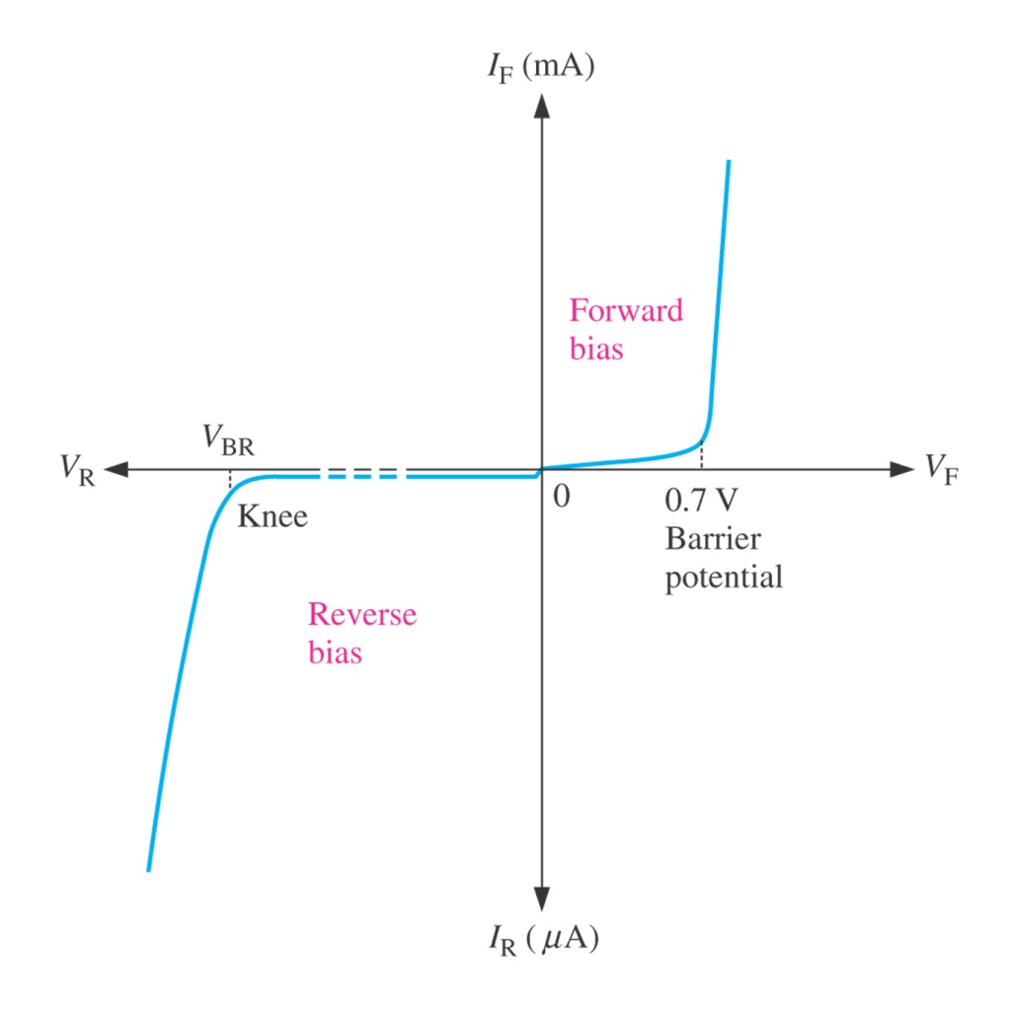
Figure 1–29 The complete V-I characteristic curve for a diode.

Slide 22
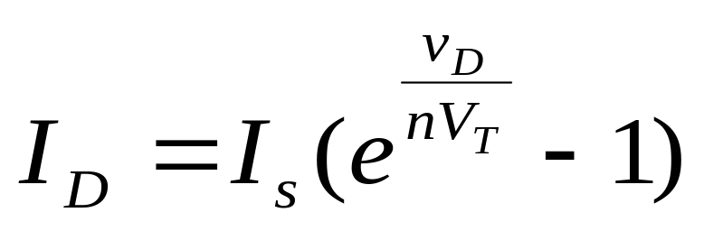
Shockley Diode Equation
A fit to the I-V characteristics of a diode yields the following equation, known as the ideal diode equation:
The thermal voltage, V_{T} = kT/q
V_{T} = 25.9 mV when T = 300K (room temperature)
I_{s} = reverse saturation current

Slide 23
Properties of Diodes
The Shockley Equation
The transconductance curve on the previous slide is characterized by the following equation:
I_{D} = I_{S}(e^{VD/ηVT} – 1)
As described in the last slide, I_{D} is the current through the diode, I_{S} is the saturation current and V_{D} is the applied biasing voltage.
V_{T} is the thermal equivalent voltage and is approximately 26 mV at room temperature. The equation to find V_{T} at various temperatures is:
V_{T} = kT
q
k = 1.38 x 10⁻²³ J/K T = temperature in Kelvin q = 1.6 x 10⁻¹⁹ C
η is the emission coefficient for the diode. It is determined by the way the diode is constructed. It somewhat varies with diode current. For a silicon diode η is around 2 for low currents and goes down to about 1 at higher currents

Slide 24
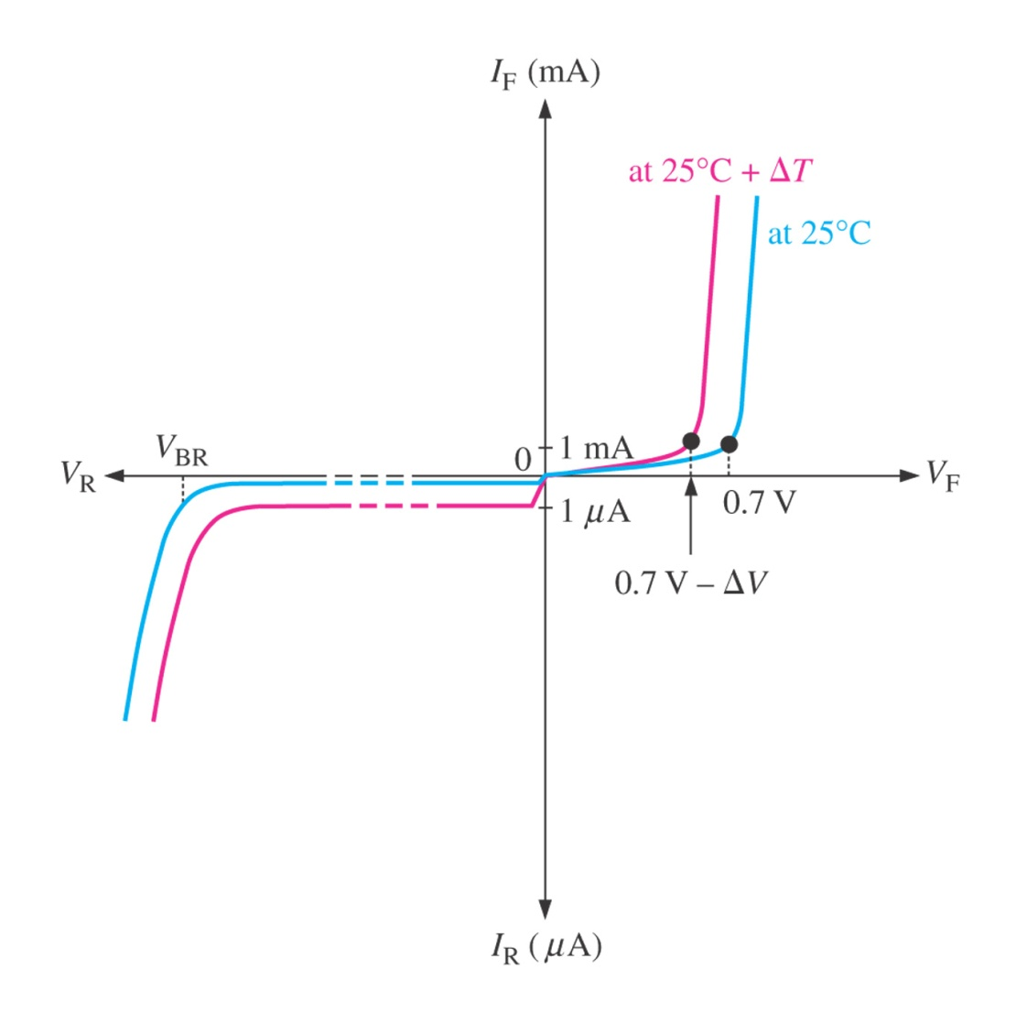
Figure 1–30 Temperature effect on the diode V-I characteristic. The 1 mA and 1 mA marks on the vertical axis are given as a basis for a relative comparison of the current scales.

Slide 25
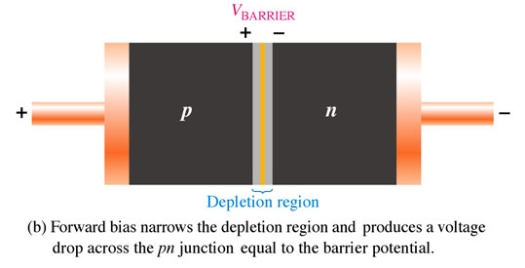
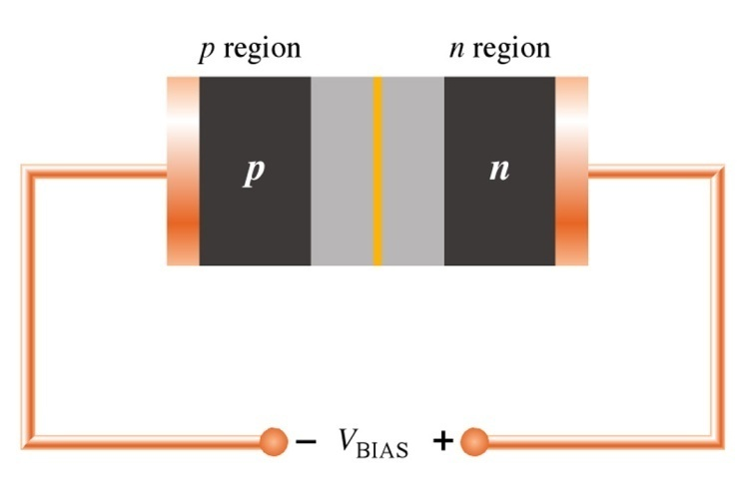
Forward and Reverse Bias
Forward Bias
Reverse Bias
Voltage source or bias connections are + to the p material and – to the n material.
Bias must be greater than .3 V for Germanium or .7 V for Silicon diodes.
The depletion region narrows.
Voltage source or bias connections are – to the p material and + to the n material.
Bias must be less than the breakdown voltage.
Current flow is negligible in most cases.
The depletion region widens.
Notes:
Fig. 1-22b depletion region forward & Fig. 1-23 depletion region reverse

